Slide 1
June 7, 2019
OCLC Update
Tony Melvyn
Product Manager, Resource Sharing

Slide 2
Topics for today
Facts and Stats
The Tops
Recent enhancements
Looking ahead
You the Community
Questions

Slide 3
Indiana ILL by source
WorldShare ILL 80
ILLiad 29
Tipasa 6

Slide 4
Tipasa in Indiana
OCLC Symbol Reg ID Library/Institution Name
FW8 University of Saint Francis
IE0 Indiana University, East
III University of Indianapolis
IU0 Indiana University, Kokomo
IUE University of Evansville
IWC Wabash College

Slide 5
Top Indiana Lenders
Rank Symbol Name
9 IUL INDIANA UNIV
42 IND UNIV OF NOTRE DAME
62 IPL PURDUE UNIV
122 IUP INDIANA UNIV PURDUE UNIV INDIANAPOLIS L
143 IBS BALL STATE UNIV LIBR
156 IMF ALLEN CNTY PUB LIBR
173 IMC INDIANA WESLEYAN UNIV MARION LIBR
199 I3U INDIANA UNIV S BEND
268 ISU INDIANA STATE UNIV LIBR
284 IMD INDIANAPOLIS PUB LIBR

Slide 6
Top Indiana Borrowers
Rank Symbol Name
16 IBS BALL STATE UNIV LIBR
19 IUL INDIANA UNIV
38 IPL PURDUE UNIV
48 IND UNIV OF NOTRE DAME
84 SHARE INDIANA ST LIB
124 III UNIV OF INDIANAPOLIS
152 ISU INDIANA STATE UNIV LIBR
203 IVU VALPARAISO UNIV
206 IDU DEPAUW UNIV
229 HV6 PURDUE UNIV FT WAYNE

Slide 7
Top Ten Indiana Novelist in WorldCat
Which novelist born in Indiana has the most library holdings in Worldcat?
What title from that novelist?

Slide 8
4472
2555
1857
1827
2458
1748
1819
1813
1454
1396

Slide 9
Recent enhancements

Slide 11
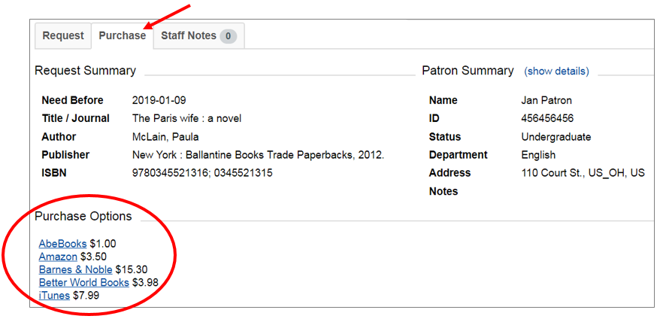
New Purchase tab

Slide 12
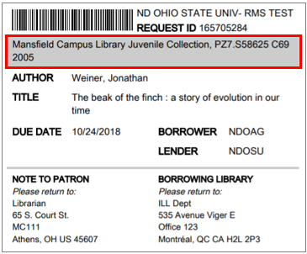
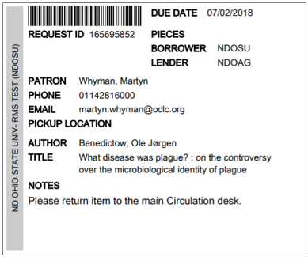
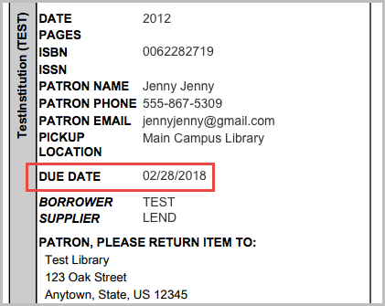
Improved printouts

Slide 13
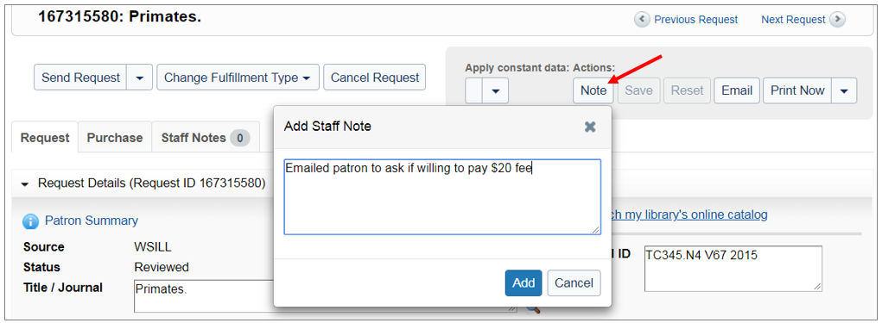
Staff Notes

Slide 14
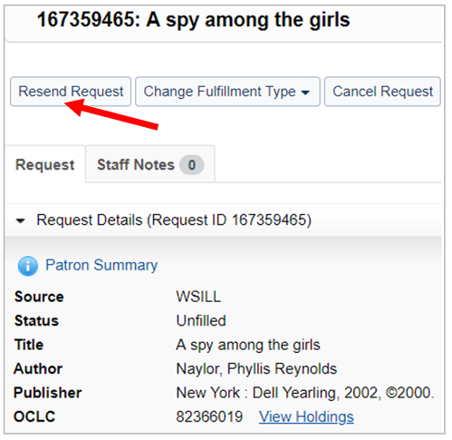
Unfilled requests

Slide 15
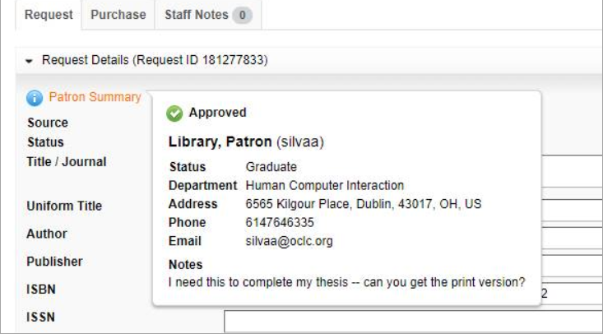
Patron Summary

Slide 16
Patron data for closed requests

Slide 17
Interoperability

Slide 18
Integrations key for interoperability
Integrations for handling workflows that touch multiple systems
Recent integrations: WS ILL: Google links Tipasa:
RapidILL
BSCAN/Scannx
Reprints Desk
Local holdings and availability (WMS, Alma, Sierra)
NCIP (WMS and Alma)

Slide 19
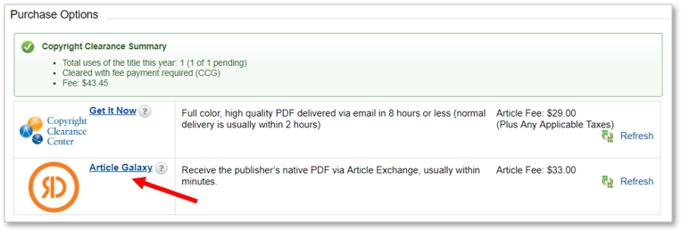
Deliver Reprints Desk articles via Article Exchange (Tipasa)

Slide 20
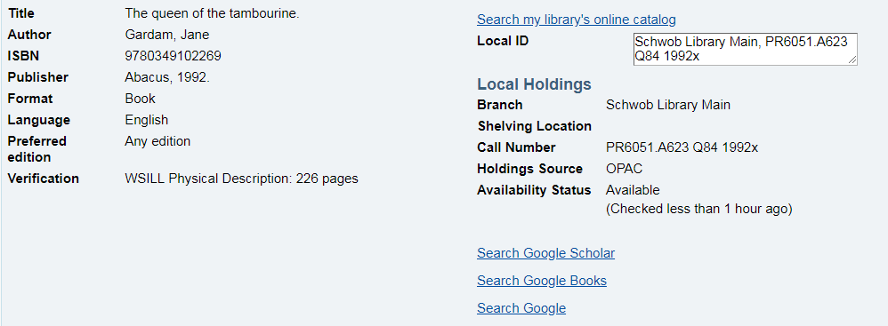
Local holdings and availability (Tipasa)

Slide 21
NCIP: borrowing integration
Circulation
Received
Create temp item + place hold
Returned
Check in
Shipped
Pass through lending charges
Notes:
Five available circulation integrations, or NCIP messages…
For borrowing, there are three Tipasa borrowing statuses that have corresponding automations that can be set up for Alma Circulation.
When a request is marked as Received in Tipasa, a temporary item and hold are automatically created in Circulation
When a request is marked as Returned in Tipasa, the item is automatically updated in Circulation as checked in
A third option for passing through lending charges is also available at Shipped, but we won’t necessarily be cover this integration today

Slide 22
NCIP: lending integration
Circulation
Shipped
Check out
Completed
Check in
Notes:
This slide shows the Tipasa lending statuses and the corresponding automations that can be set up for Alma Circulation.
When a request is marked as Shipped in Tipasa, the item is automatically moved to a temporary location so that it shows as unavailable.
When a request is marked as Completed in Tipasa, the item is moved back to it’s permanent location so that it shows as available.

Slide 23
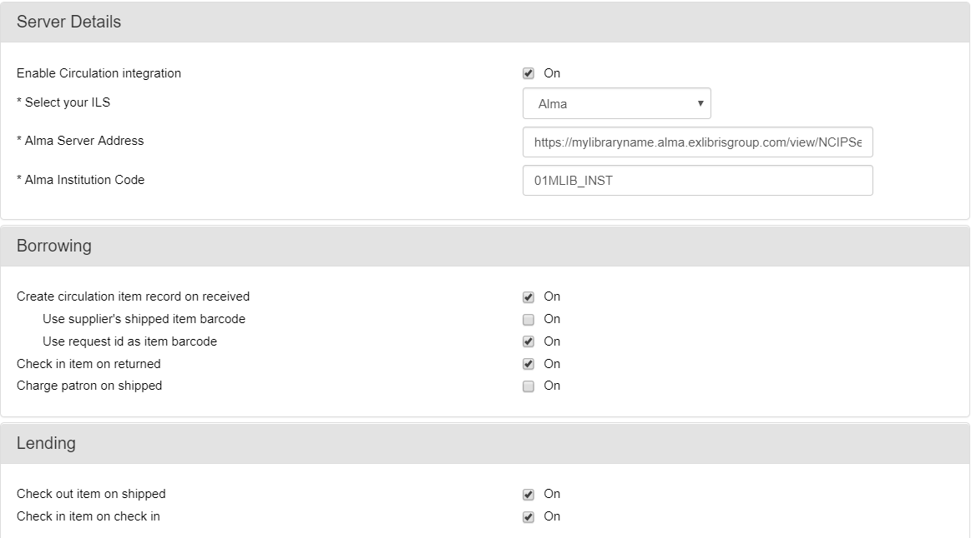
Tipasa-Circulation integration (Alma)

Slide 24
Looking ahead

Slide 25
WorldShare Report Designer for Tipasa
Use WorldShare Report Designer for ILL statistics
Build custom reports and visualizations that meet your specific library needs
Available in June
Report Designer training also available in June

Slide 26
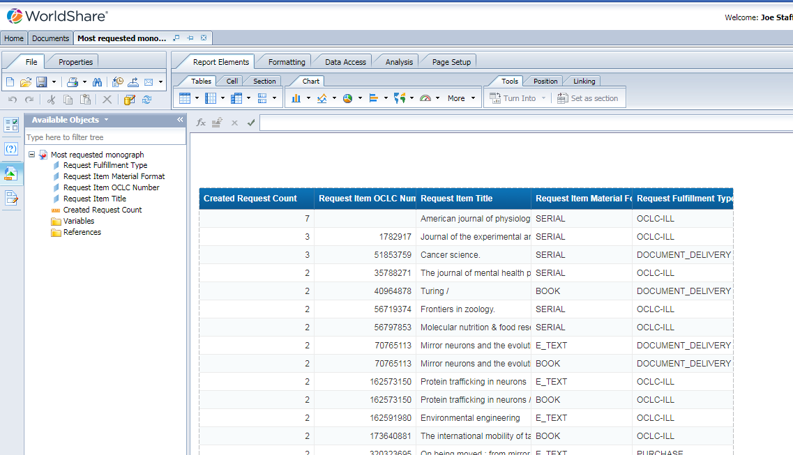
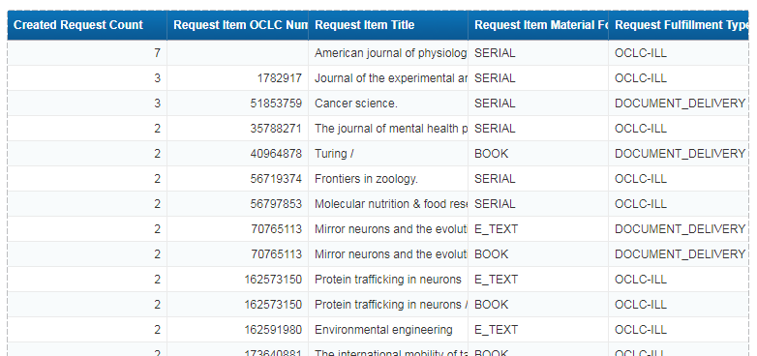
Report Designer sample report

Slide 27
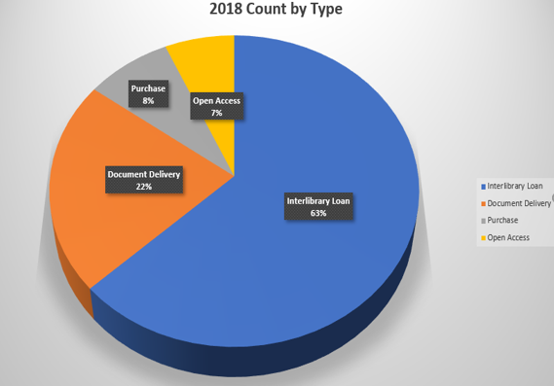
Report Designer sample report

Slide 28
June release for WS ILL and Tipasa
Receive alert when borrowing request reaches end of lender string
Use book straps/stickers for both pull slip and shipping
Branch workflow process improvements (Tipasa only)
Cloning of requests in user portal (Tipasa only)

Slide 30
Later in 2019…
Still finalizing list of features/enhancements for next quarter. A few items currently on the list:
Additional reasons for no
Direct request enhancements to help customize your workflows
Continued branch workflow process improvements
API testing and development with advisory group
Patron text notifications (Tipasa only)
Notes:
APIs
July-Dec 2019: API first iteration
2020: Additional API support

Slide 31
ISO 18626
ISO 18626 Information and documentation – Interlibrary Loan Transactions New standard protocol designed for ILL transactions which will eventually replace the old 1980’s standard
What it means for the ILL community Better/more interoperability between ILL systems ability for requests to move from one system to another
Notes:
Another key area for increasing interoperability is the new ISO standard that has been written

Slide 32
Next steps for ISO 18626 implementation
Toolkit created at OCLC
Tipasa and D2D to begin implementing the toolkit in second half of 2019
Looking forward to sharing information about what we learn as we test out the new standard later this year
Notes:
Our Tipasa and D2D will be able to test the new standard between our 2 systems once we’ve implemented the toolkit in both products.
We are looking forward to sharing information about what we learn as we test out the new standard later this year

Slide 33
Our Approach
Great User Experiences
Fast and Predictable
Interoperability
End-to-end mindset
Collaborative
Data driven
Automation
Remove friction
Transparent
APIs
Standards
In/Out of OCLC

Slide 34
Your role

Slide 35
Notes:
The OCLC Community Center gives our members the opportunity to connect with your peers, and with the OCLC product teams.
As well as a space for submitting enhancement requests

Slide 36
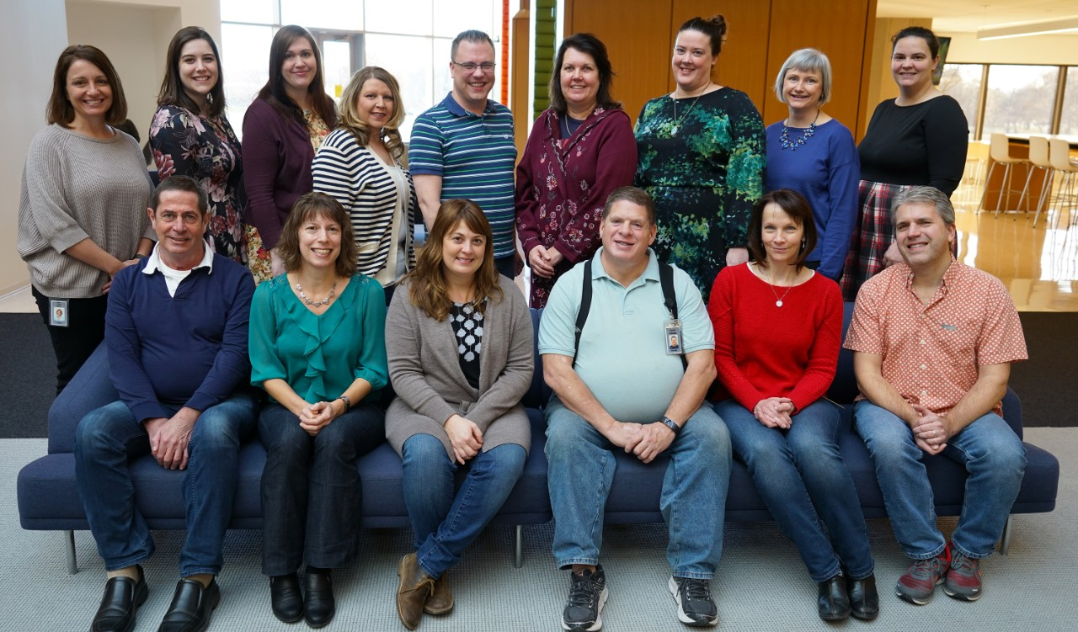

Slide 37
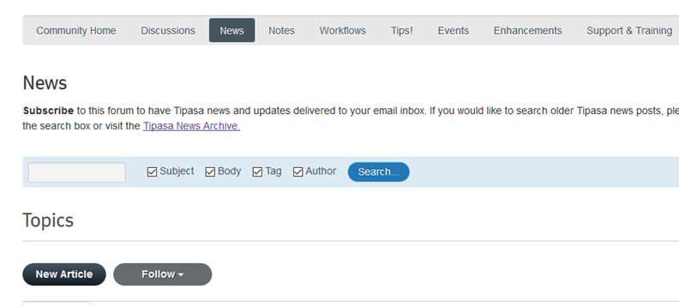
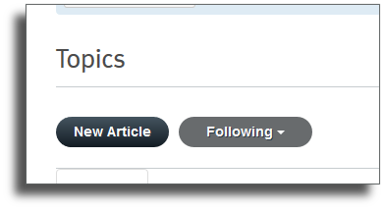
Subscribe to News

Slide 39
And finally

Slide 40
ILL requesting in FirstSearch & WorldCat Discovery
FirstSearch/WorldCat Discovery subscription funded by the IN State Library will end on 12/31/19
Will impact ability for users to request items with an ILL request form directly from search results in FirstSearch or WorldCat Discovery
A number of Indiana users of ILLiad, Tipasa, WorldShare ILL are receiving requests from FirstSearch or WorldCat Discovery
To learn about FirstSearch/WorldCat Discovery subscription options beyond 12/31/19 please contact OCLC at libservices@oclc.org
Notes:
The form automatically populates with citation information, so there’s no need to decipher handwriting or to correct the request. Making ILL requests easy saves staff time and helps you deliver the resources your users need.

Slide 41
Questions?

Slide 42
Thank you!
Tony Melvyn
Product Manager, Resource Sharing
melvynt@oclc.org

