Slide 1
The Ultimate Resource Sharing:
Bridging Public and School Libraries

Slide 2
Who we are:
Diane Huerkamp Executive Director, Mooresville Public Library
Megan Edwards Teen Outreach Librarian, Mooresville Public Library

Slide 3
Collaboration, Resource Sharing, and Building Relationships
Cook Endowment & donations
Evergreen Indiana ILS
Evanced
Link Observatory
Got Access 2003
Overdrive consortium
Indiana Share
SRCS
Museum passes
Notes:
consortium of 121 public, school and institutional libraries located throughout Indiana
calendar & room reservation which is now a product of Demco
- Library Rewards - First Merchants Bank

Slide 4
Collaboration, Resource Sharing, and Building Relationships
Franciscan Health
Mooresville Main Street
Friends of the Library
Miller’s Nursing Home
Tri Kappa Art show
Mooresville Fire Department and Police Department
Citizens Bank
Shared IT specialists MCSC & Plainfield-Guilford Township PL
Mooresville Parks Department
Notes:
Miller’s Nursing Home - Outreach = bus for PDD tour of our town
FOL/ alumni raise funds/ Advocacy
- PDD bags for staff, cloth bags for patrons & treated us to Chick Fil A breakfast
Storytime @ Pool- cherry picker change out my lights on parking lot & soaring eagle

Slide 5
An Idea is Formed
Paul Hadley Middle School had been without a librarian of any sort for several years.
Had a background in school libraries and a strong sense of community.
Wanted to collaborate with Mooresville Consolidated School Corporation.

Slide 6
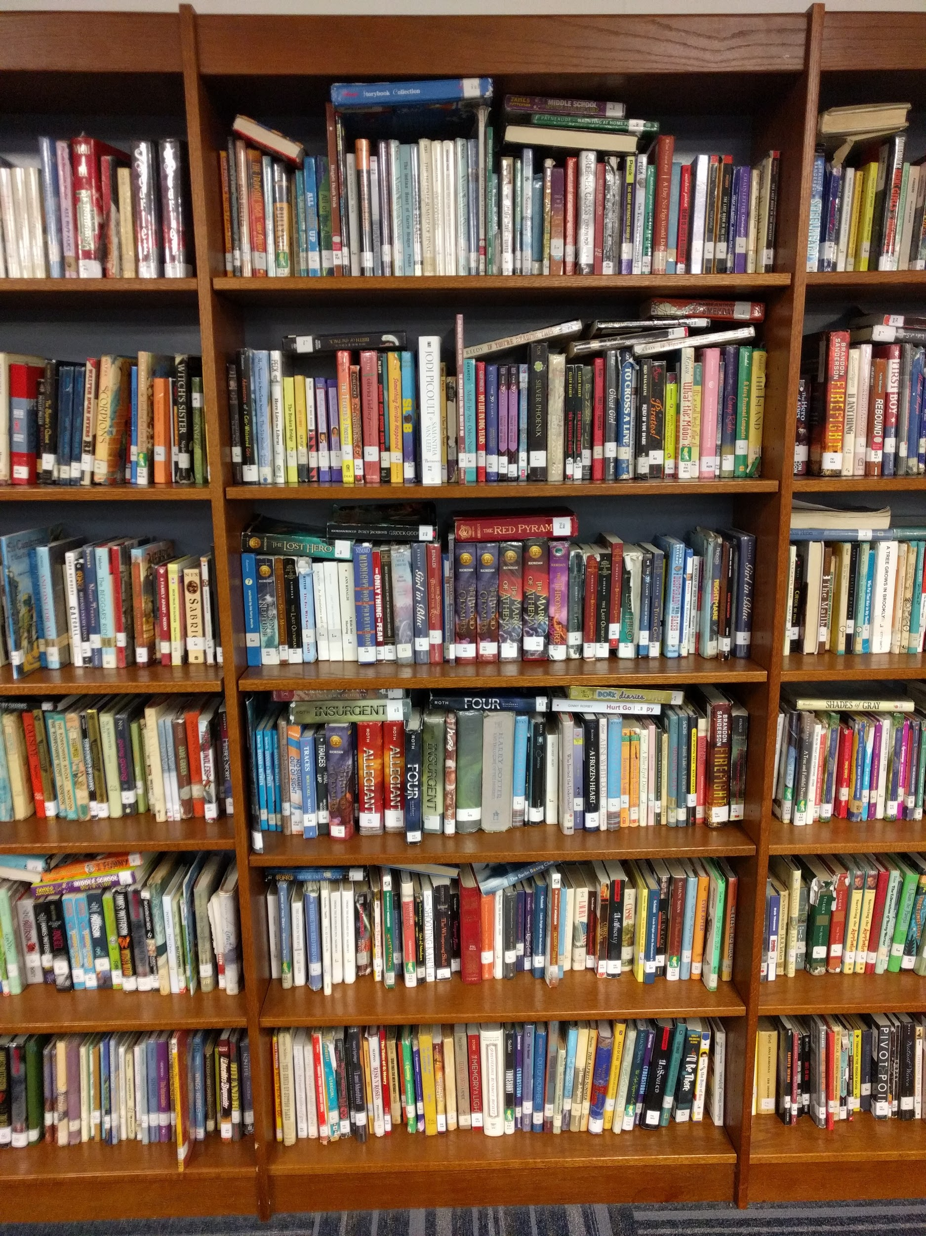
A Need is Met
BS in Elementary Education
Worked for Danville Community School Corporation in various roles.
Worked at Danville Public Library.
Hired for current position in July 2017.
Stepped foot in the school the week before classes started.
The shelves were packed!

Slide 7
Notes:
Focus this year was placed on updating and organizing the collection. Items that had not been checked out in 3 years or more, items that were beyond repair, and items that were factually inaccurate were removed, also known as weeded. This is an ongoing process and will be less aggressive in the coming years.
The collection continues to have new items added. Profits from book fairs and donations have helped a lot this first year. Any future book fair profits as well part of a library budget will go towards purchasing new items. Digital books and digital audiobooks are purchased in collaboration with the high school.
The overall goal is to provide students and teachers with a contemporary, useful, and well-rounded collection of fiction and non-fiction titles.

Slide 8
Notes:
Weeding has continued, but to a lesser degree than last year. Non-fiction titles are in need of more updating. I'm striving to develop and current and useful collection.
This year I was able to begin a subscription to Junior Library Guild, which delivers 12 books each month based on predetermined categories such as "Sports," "Mystery," "Graphic Novel," and "Non-Fiction." I have been pleased with the quality of the books and the selections. I am able to swap books before a shipment.
I am about to host my third book fair of the year. I switched from Scholastic to Follett this year and have been very pleased with the ease of setup, the book selection, and the rewards. I hope our book fair success continues to grow as they become more regular.
For the first year, I spent half days at the middle school alternating between mornings and afternoons.
This year, I altered my schedule to half days on Mondays, all day Wednesdays, and all day Fridays. I like this better because I am there for the entire school day most of the time.
The new schedule also allows the library to be used for non-library purposes when I'm not there.
The library space is very much multipurpose. It is used for staff luncheons, staff training, large group instruction, and food pantry.
The library also houses the Adult & Child family counselors, the speech therapist, lost and found, and a workroom.
Switched from Scholastic to Follett for book fair vendors. The schools use Follett for their ILS and collection analysis. The quality and age-appropriateness of the fair has improved.
I open the library for student lunches on Monday, Wednesday, and Friday. Students sign up for a spot in the library before lunch. There is a regular group of students who eat lunch in the library. I've been pleased with the relationship building.
In March 2019, I registered all eligible PHMS students into Evergreen with Computer Usage Cards. This gives them access to Mooresville Public Library's digital resources.

Slide 10
Future Plans
Increase circulation
Increase teacher collaboration
Continue to improve collection
Continue to host book fairs
7th and 9th graders receive digital resource cards every year
Increase school library presence in the school

Slide 11
Resource Sharing
We need to be good stewards of our resources.
We can increase public awareness of the vital role libraries play in our communities - academic, public, school, and even special.
We are demonstrating our usefulness to our legislators, our Deans or departments, our donors & our funders.

Slide 12
What relationships, collaboration, partnerships have you built, who is your next partner?

Slide 13
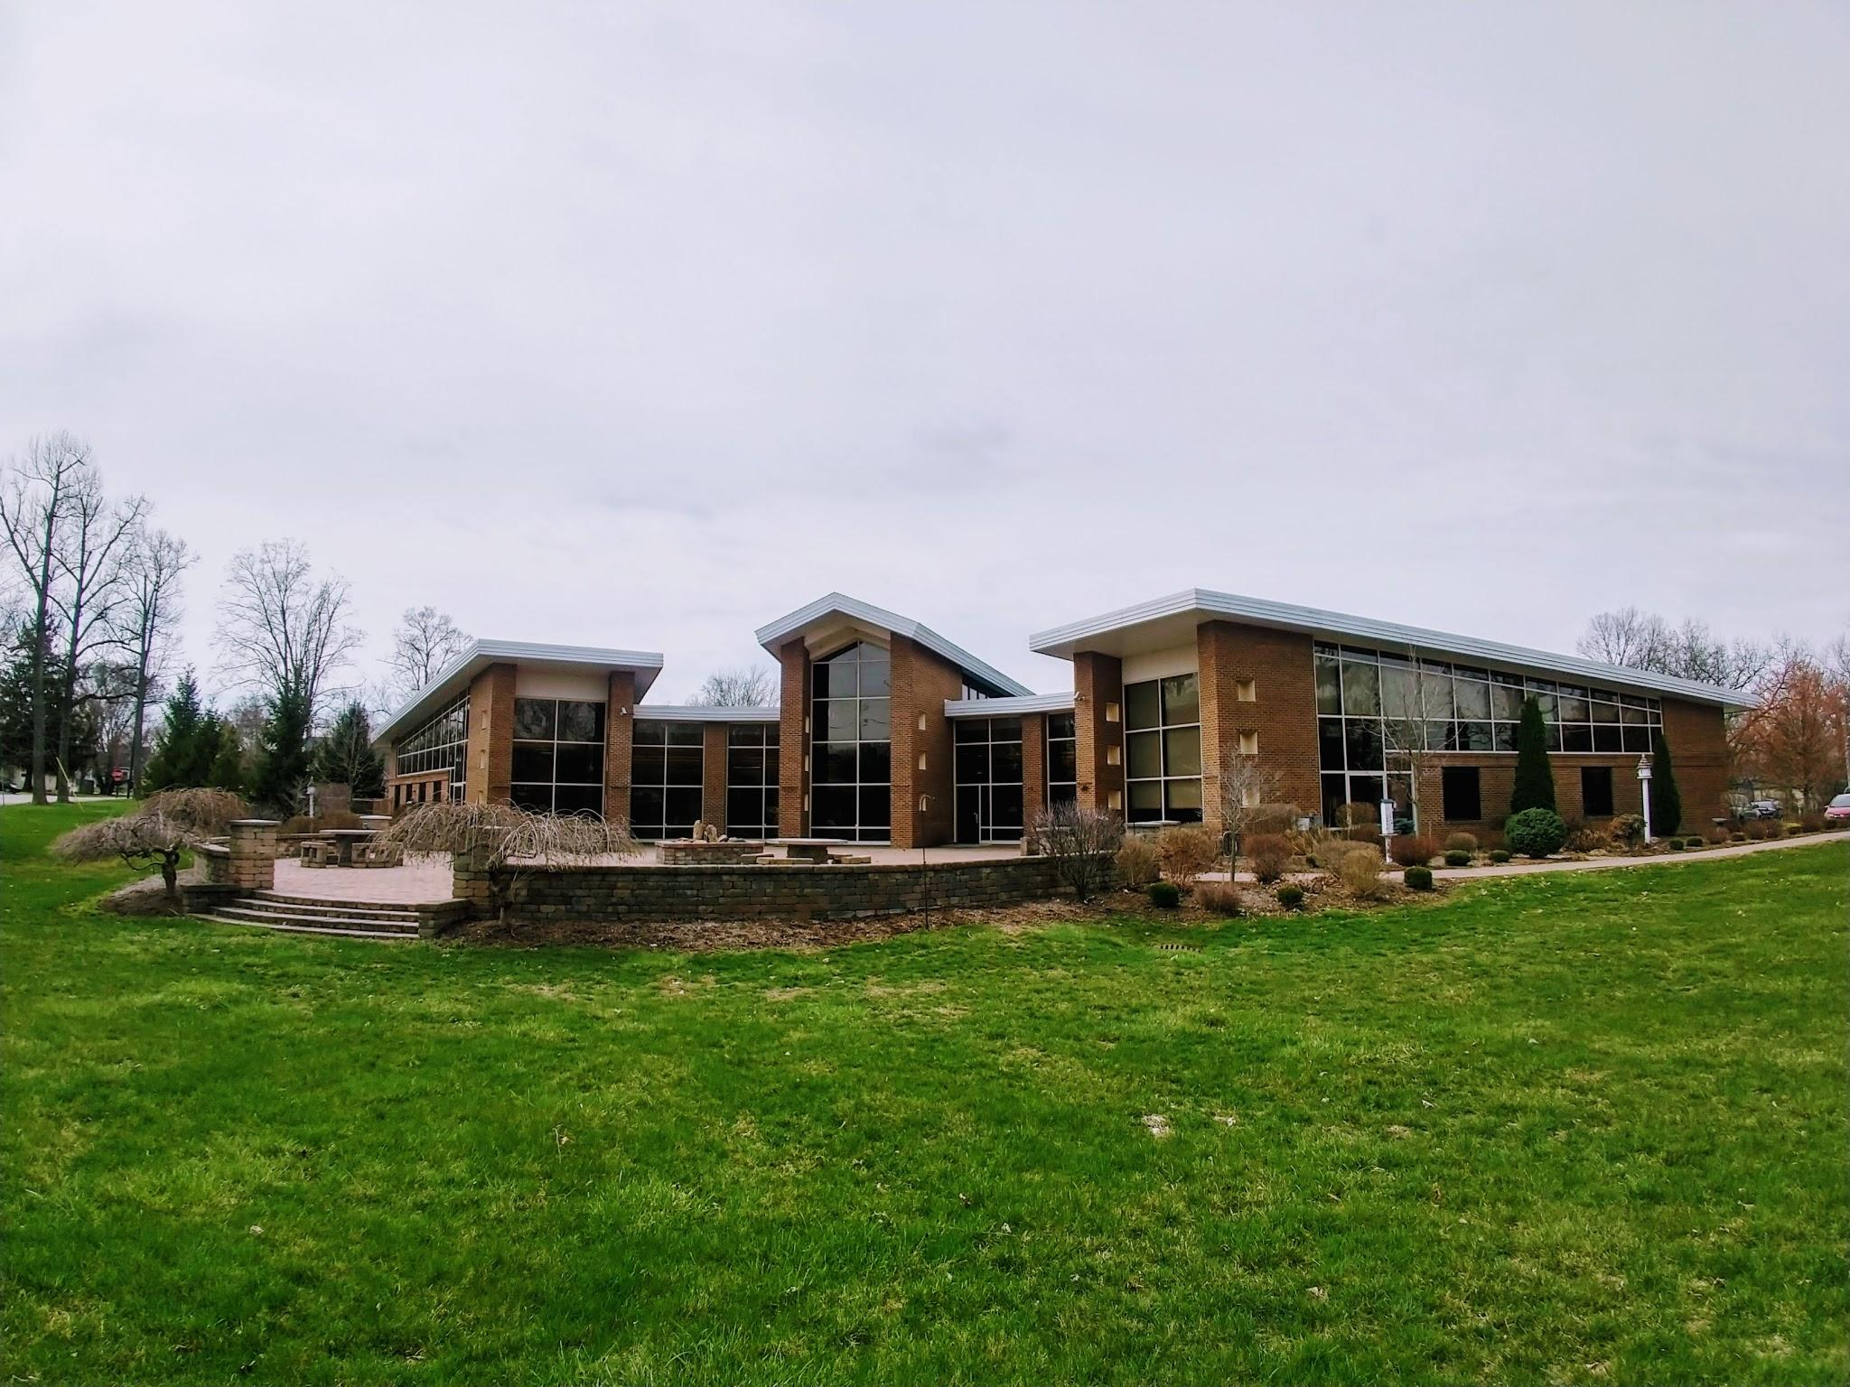
Contact us:
Diane Huerkamp, Director
dianeh@mooresvillepublic.lib.in.us
Megan Edwards, Teen Outreach Librarian
megane@mooresvillepublic.lib.in.us
Mooresville Public Library
220 West Harrison St
Mooresville, IN 46158 www.mooresvillelib.org
317.831.7323

