Slide 1
Electronic Resources Licensing as a Public Service
Nathan Rupp
Purdue University Fort Wayne
Discovery to Delivery 9: Resource Sharing: To Bolding Go!
Indianapolis, IN
June 7, 2019

Slide 2
Six questions
WHO are our users?
WHEN are our users using the licensed resources?
WHERE are our users accessing these resources from?
WHY are our users using these resources?
WHAT resources are our users actually using?
HOW are our users accessing these resources?

Slide 3
WHO are our users?
Librarians
Interlibrary loan
Assessment
Electronic resources management
Public services/reference
Students
What about collaboration?
Electronic reserves

Slide 4
WHO are our users?
Faculty
Different uses than students
Teaching: LMS, public performance
Research: text mining
Robots Reading Vogue
Staff
Development Office
General Counsel’s Office

Slide 5
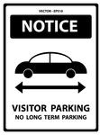
WHO are our users?
Alumni
Does the vendor also sell the product to alumni?
Check with alumni office!
Walk-in Users
Not just the library!

Slide 6
WHO are our users?
Users at Other Universities
What about international ILL?
Disabled Users
Use of assistive technologies
VPAT
National Association of the Deaf vs. Harvard

Slide 7
WHEN are our users using the licensed resources? 24/7
Downtime vs. uptime
Planned vs. unplanned outages
What’s our risk tolerance?

Slide 8
WHEN are our users using the licensed resources? Right now
Up to date metadata and links
Click through contracts
Breaches

Slide 9
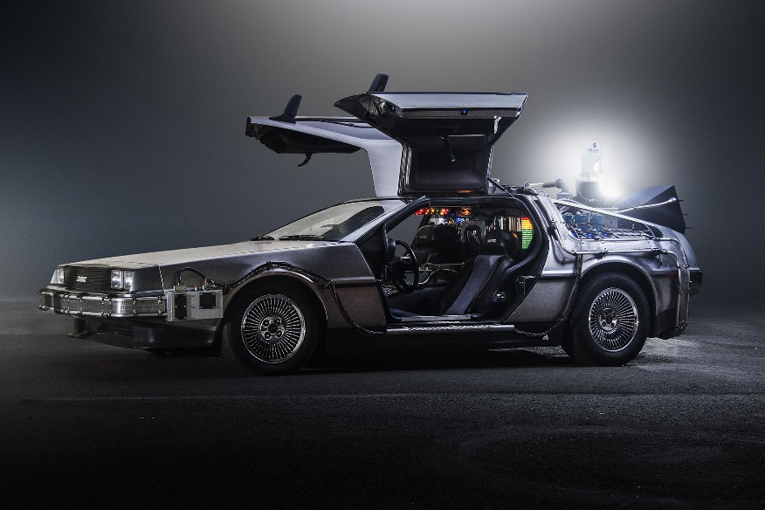
WHEN are our users using the licensed resources? Future users
CLOCKSS/LOCKSS/Portco?
Pile of hard drives or FTP?

Slide 10
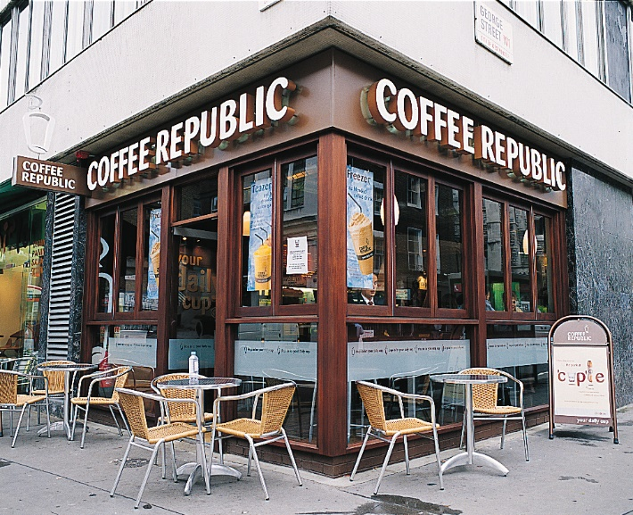
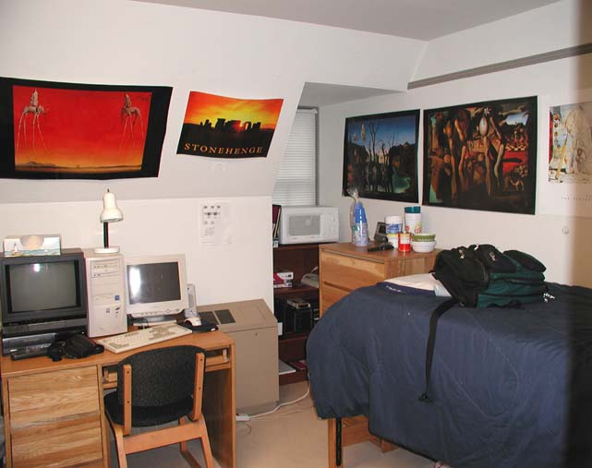
WHERE are our users accessing these resources from?

Slide 11
WHERE are our users accessing these resources from?

Slide 12
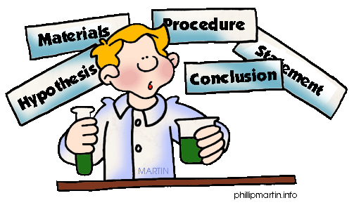
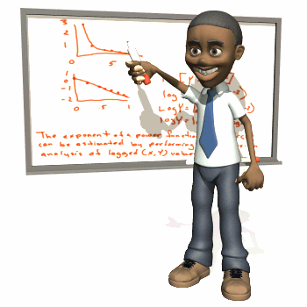
WHY are our users using these resources? Functional differences
Research: “Studious inquiry or examination, especially: investigation or experimentation aimed at the discovery and interpretation of facts, revision of accepted theories or laws in the light of new facts, or practical application of such new or revised theories or laws.” (1)
Teaching
Learning

Slide 13
WHY are our users using these resources? Differences in discipline
Systematic reviews
Public performance rights
Data manipulation

Slide 14
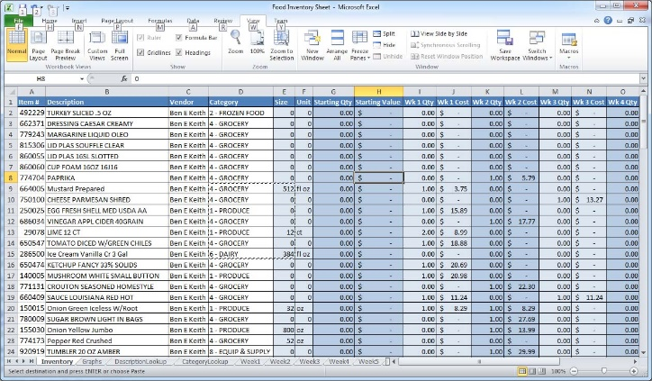
WHAT resources are our users actually using?
eJournals: advertisements, letters to the editor, pre-pub articles
eBooks: simultaneous users, chapter or full-book downloads, acceptable devices (Kindle)
Datasets: downloadable, accessible via SAS, storage on local servers
Video: public performance rights
Audio: acceptable devices, streaming vs. downloading

Slide 15
HOW are our users accessing these resources?
Patrons with disabilities – WCAG compliant
Multiple platforms – responsive design
Library systems
Metadata (and how to obtain it)
Knowledge base
Interoperability with discovery layers
Sharing licensing information
Ease of access
Username/password or IP
Open Athens

Slide 16
Thank you! Any questions?
Nathan Rupp
Director of Technical Services and Information Technology
Walter E. Helmke Library | Purdue University Fort Wayne
(260) 481-6086 | ruppn@pfw.edu

Slide 17
Notes
1. https://www.merriam-webster.com/dictionary/research. Accessed June 6, 2019.

