Slide 1
Nicole Brock, ISL Matt Straub, NOW Courier

Slide 2
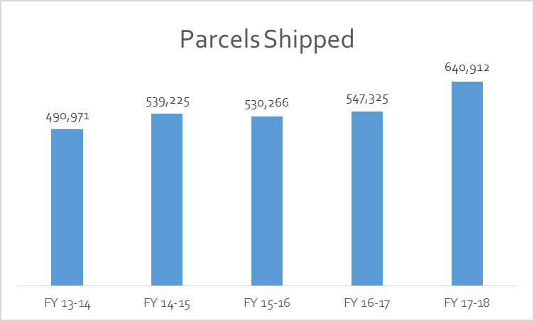
More Parcels
30%

Slide 3
More Items
ILL
SRCS
88%
134%
?
Public Library Sharing
Evergreen Sharing
Other Libraries
Public Library Statistics, Table 8, 2014-2018 – “provided to other libraries”

Slide 4
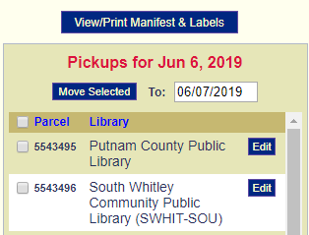
A work in progress…
Supply order form (June 2018)
Check parcel (August 2018)
Move parcel (May 2019)
Data sharing between NOW and ISL
Multiple user accounts

Slide 5
Best Practices
Make sure you select the correct library. Double check.
Use the notes field to include information about parcel contents - scanning item barcode(s) is one easy way.
Tape the labels in the window, but go easy on the tape.
Report service issues to the State Library.
Update your days unavailable, if closed on an InfoExpress day.
Send excess bags back to the Indiana State Library.

Slide 6
Renew for 2019-2020
 | Public Academic Special | School
Renewals Due | July 1 | September 1
Payment Due | July 31 | September 30
Service will be suspended for libraries that do not submit renewals/payments by the above deadlines.
All renewals or payments processed after the due date are subject to a 2% late fee.

Slide 7
Questions?
InfoExpress@library.in.gov
800-451-6028
317-232-3699

